Slide 1
ShoppingCart 2.0
Michel, Seth, Winfried
CSE 481 Robotics

Slide 2
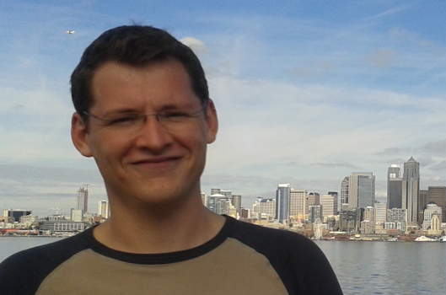
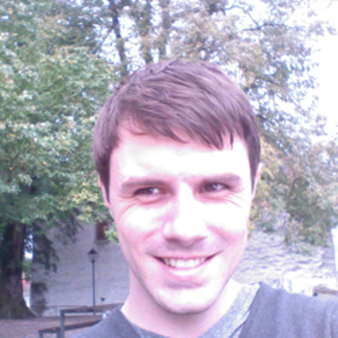
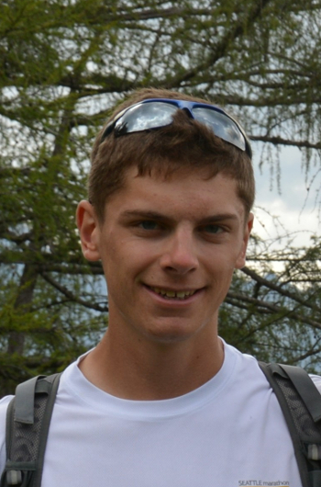
INTRODUCE TEAM

Slide 3
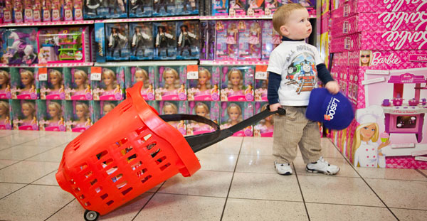
MOTIVATION
http://advertising.lasoo.com.au/wp-content/uploads/2012/08/lasoo-shopping.jpg

Slide 4
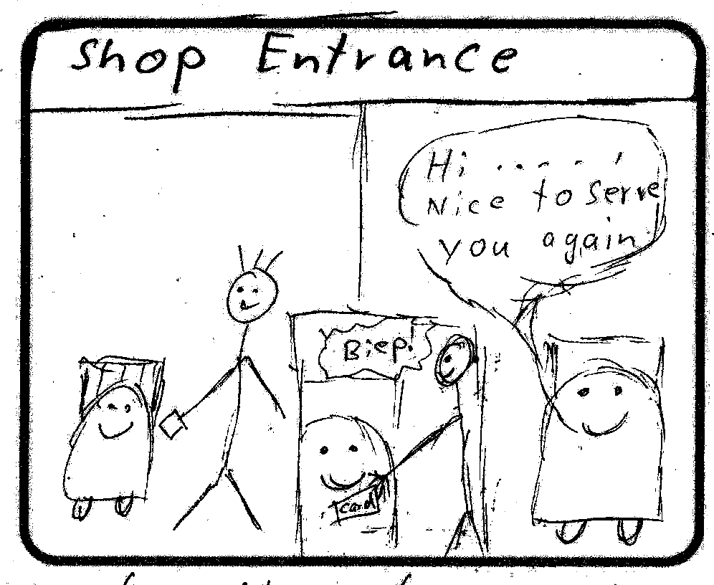
STORYBOARD (General Idea)

Slide 5
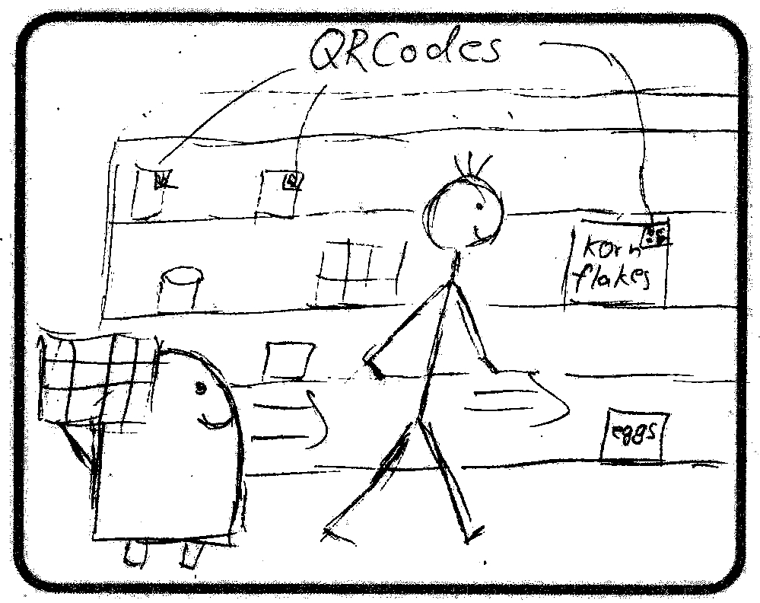
STORYBOARD

Slide 6
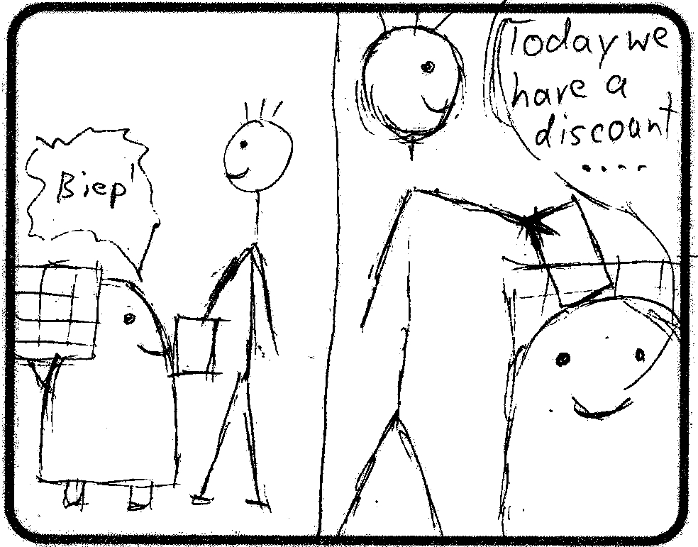
STORYBOARD

Slide 7
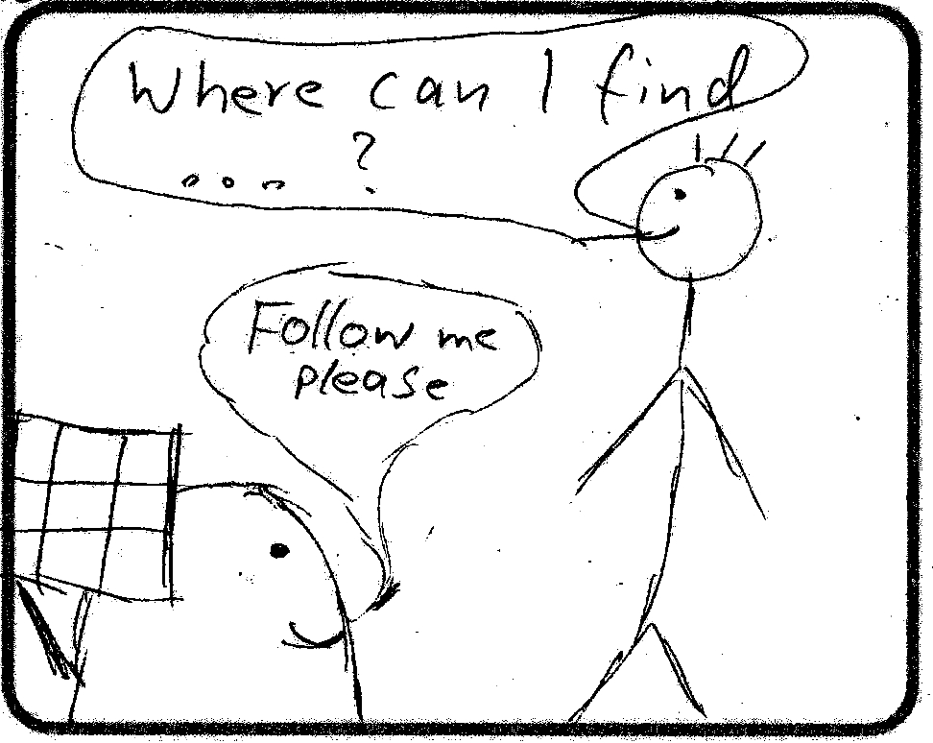
STORYBOARD

Slide 8
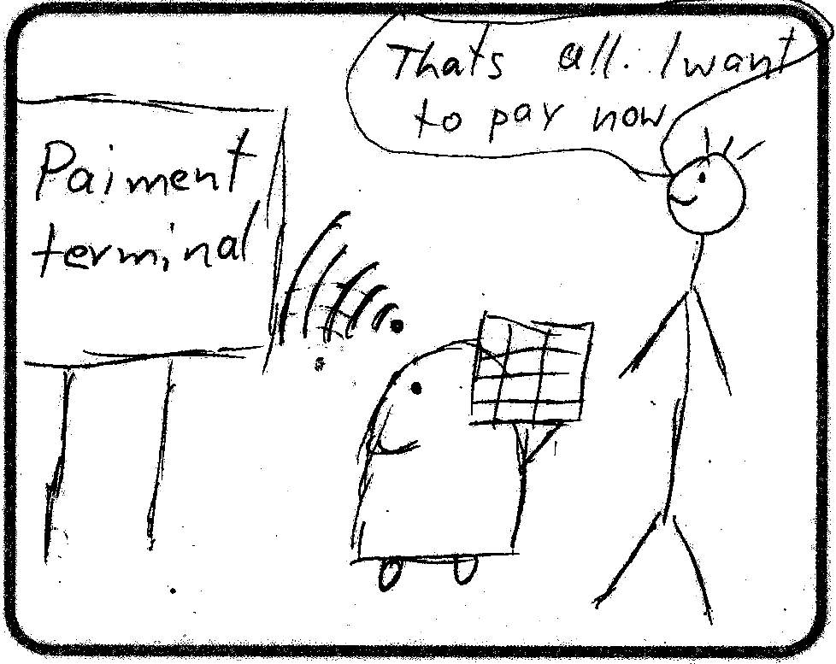
STORYBOARD

Slide 9
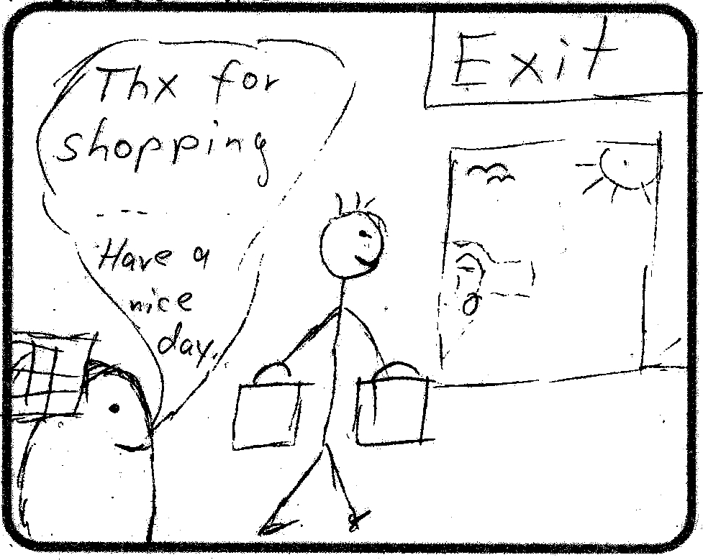
STORYBOARD

Slide 10
TECHNICAL CHALLENGES
Getting to know ROS and Turtlebot
Follow Mode
Guide Mode
Web interface (User interaction)
Mechanical Setup

Slide 11
EVALUATION
Tested functional features:
  Following, Guiding, AR Scanning, Homerun, ...
Tried to find corner cases:
  following around corners, too many legs, ...
User testing:
  Observe user doing shopping
Outcome:
  All in all it works fine
  Few issues with leg detection, speed, stability

Slide 12
DEMO!

